Slide 1


ABAP on Hana s/4 Hana Training
Day 16
contact@anubhavtrainings.com

Slide 2

Agenda – Day 16
Defining CDS BOPF
Define Business Object
Nodes of Business Object
Flow of Scenario
CDS Annotations
Building BOPF Scenario
Development Flow & Artifact
Create Fiori App on BAS
Meta Data Extension

Slide 3

CDS BOPF
The Business Object Processing Framework is an ABAP OO-based framework that provides a set of generic services and functionalities to speed up, standardize, and modularize your development. BOPF manages the entire life cycle of your business objects and covers all aspects of your business application development. Instead of expending effort for developing an application infrastructure, the developer can focus on the individual business logic. Using BOPF, you get the whole application infrastructure and integration of various components for free. This allows you to rapidly build applications on a stable and customer-proved infrastructure.

Slide 4
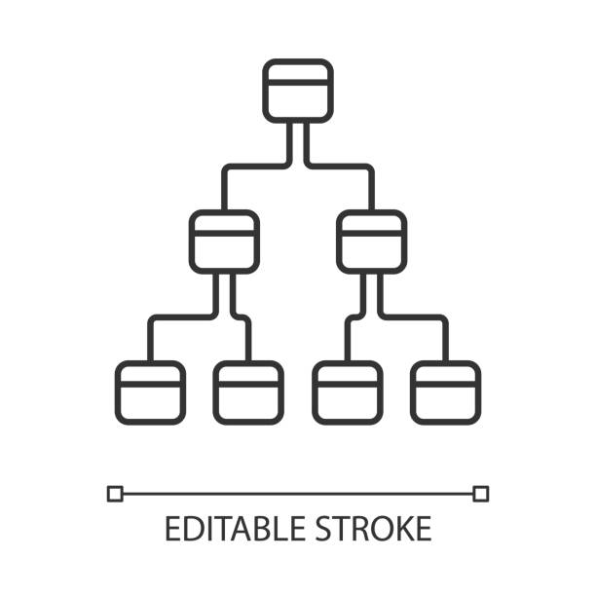
Flow of CDS Views in Hierarchy
The business objects are the basic units of the BOPF-based programming model. Business applications or processes operate on certain business objects.
A business object is represented as a hierarchical tree of nodes. A single node includes a set of semantically related business object data and the corresponding business logic.
On the technical level, each node is implemented with a regular Dictionary table, where each node instance corresponds to a single table entry (table rows).
Nodes, attributes, and alternative keys set up the data part of a business object. Again from a technical viewpoint, attributes form the columns of the table. A node serves as an anchor point for connecting the business logic of the business object.
For each node, several types of entities can be defined to form the specific business logic part of a business object.

Slide 5
Node of Business Object
Node Entity ...is used...
Action
... to implement a service (operation or behavior) of a business object. An action is explicitly triggered by a service consumer, such as the user interface.
Determination
... to provide functions that are automatically executed as soon as certain trigger conditions are fulfilled. A determination is triggered internally due to changes made to the instance of a business object.
Validation
... to either validate whether a specific action can be executed on a specific node instance (action validations) or whether a set of node instances is consistent (consistency validations).
Query
... to search for business object instances that meet certain search criteria.
Authorization Check
... to provide an authorization concept for BO nodes (for their data and for the operations on their data).
Association
... to connect business object instances that are located on different nodes.

Slide 6
Flow of BOPF Scenario
Metadata Extension CDS View.
Consumption CDS View.
Table – ZOFT_MEALS.
Draft Table - ZOFT_JUL_MEAL.
ZOFT_JUL_MEAL
ZOFT_MEALS
ZMAR_CDS_BOPF
ZMAR_MED_BOPF

Slide 7
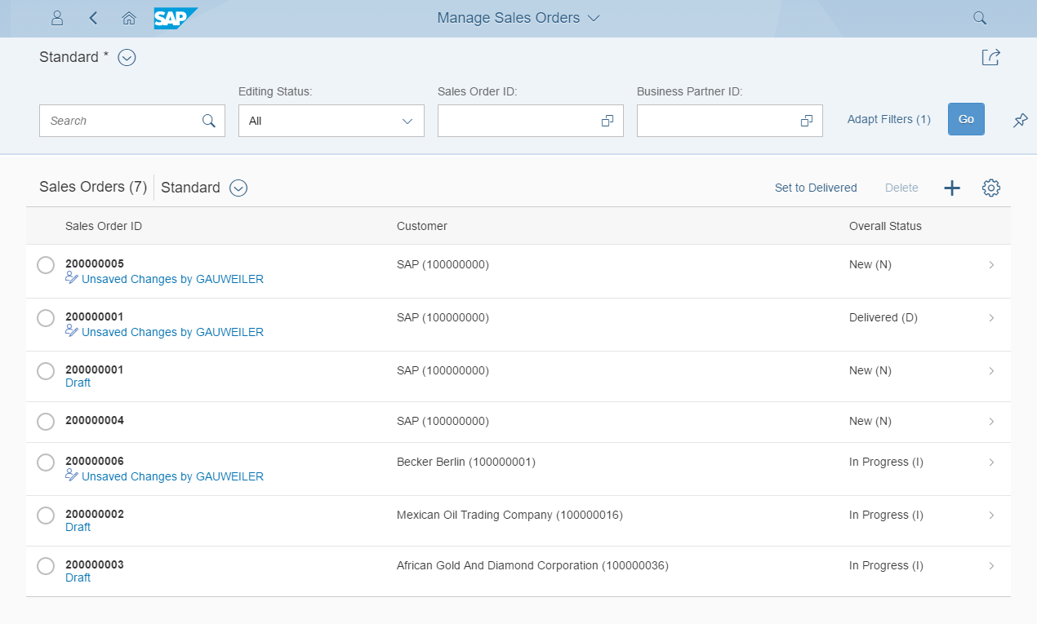
Development flow & Artifacts
BOPF (Business Object Processing Framework) is a framework for working with the BO (Business Objects). BO is a representation of a type of uniquely identifiable business entities described by a structural model, an internal process model, and one or more service interfaces.
consume
SAP Fiori Elements, …
OData Service
Consumption view
ption view
Search Object(s)
Core Data Services
generate / publish
Subnode consumption view
Subnode consumption view
Subnode consumption view
Subnode consumption view
Metadata Extension
enrich
Data Definition
BOPF Business Object
generate
implement
Custom ABAP Business Logic
CDS metadata extensions can currently only be created for CDS views. A CDS metadata extension is a CDS object that is defined and transported in a separate CDS source code.
Draft table
Database table
Draft table
Draft table

Slide 8
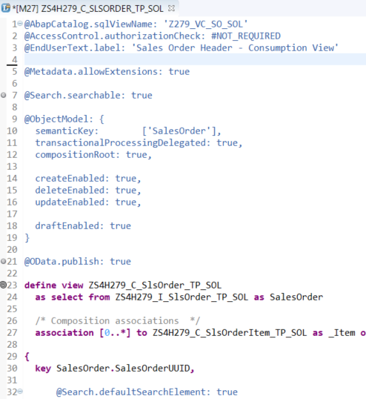
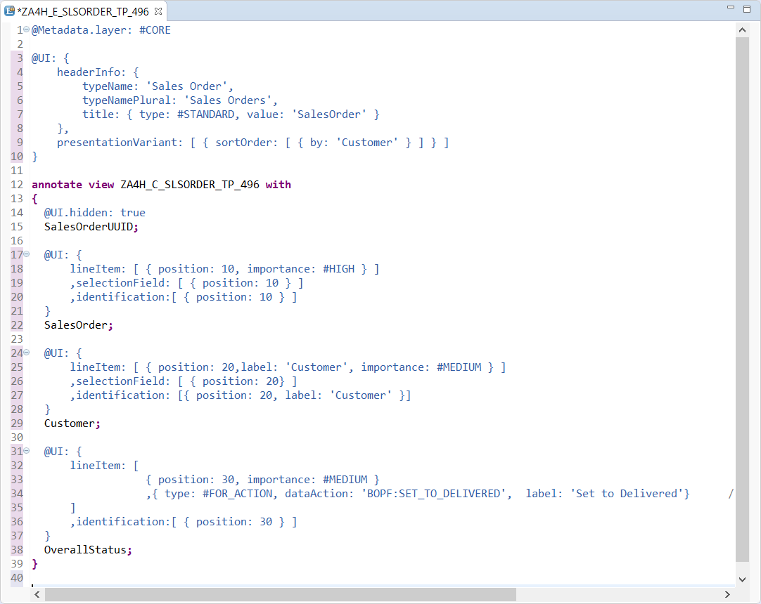
CDS Annotations
Access Control
UI semantic
Search enablement
Transactional enablement
OData exposure

Slide 9

Exercise
CDS BOPF Scenario

Slide 10
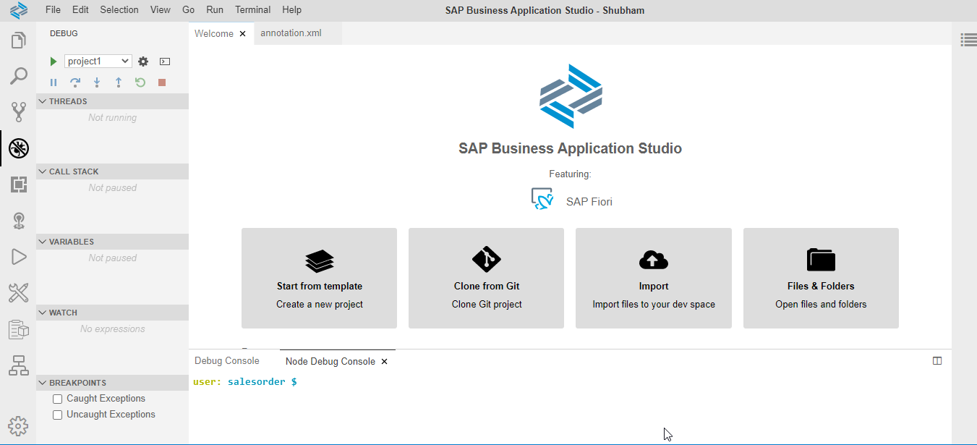
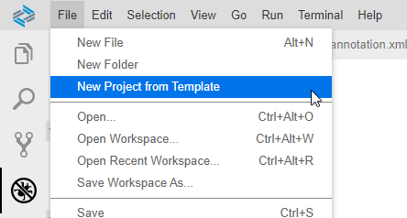
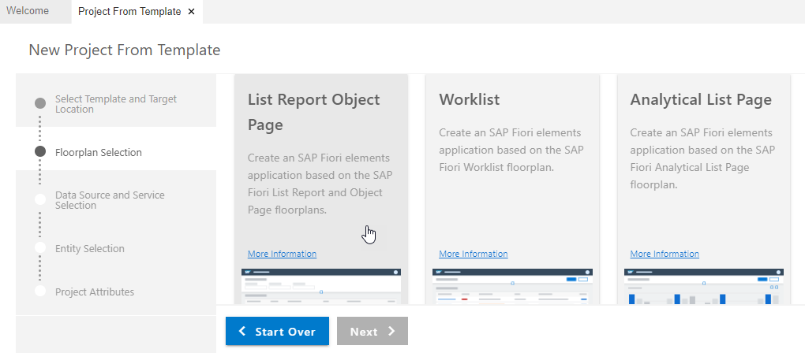
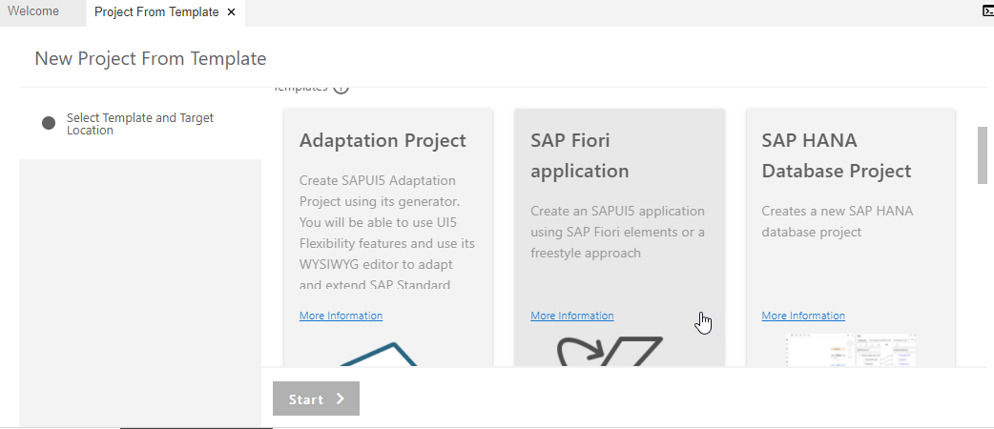
Create Fiori App with Template on BAS
Step 1. Open Business Application Studio.
Step 4. Choose List Report Object Page & Next.
Step 3. Click on SAP Fiori application & Next.

Slide 11
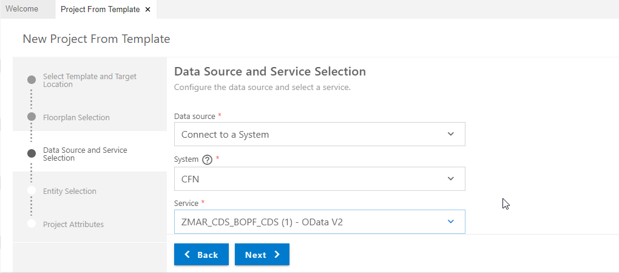
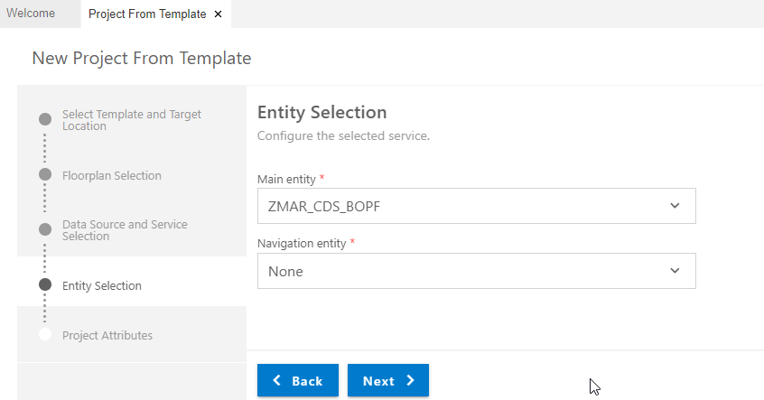
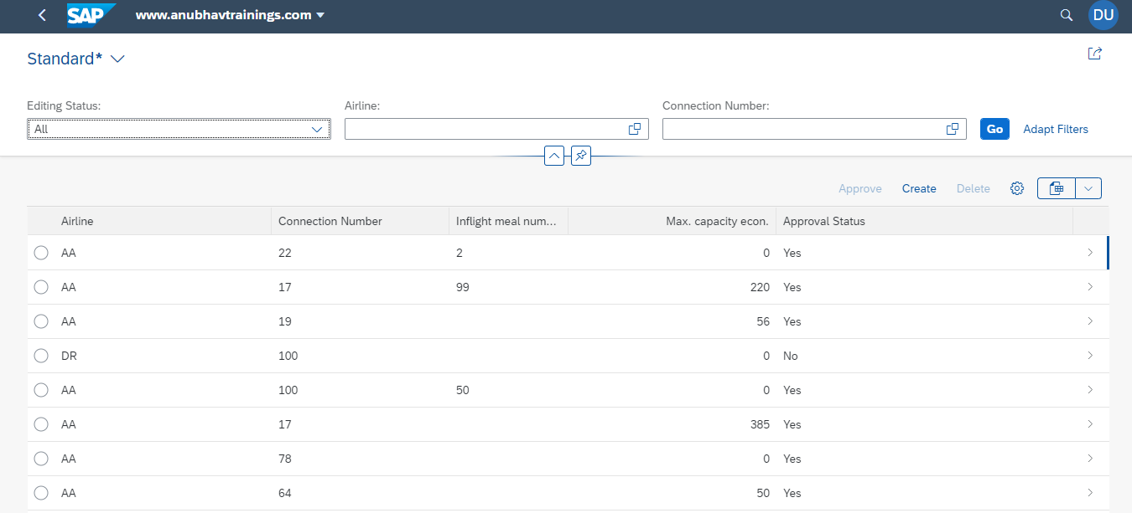
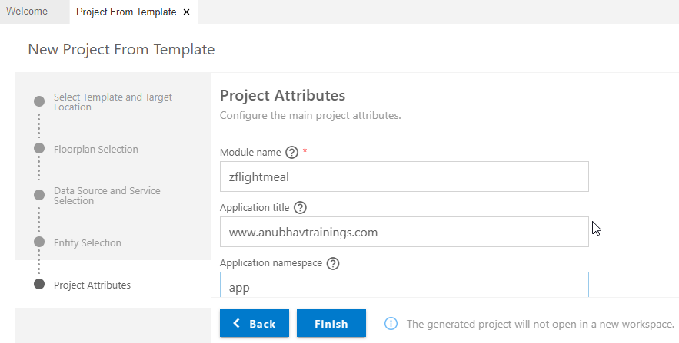
Create Fiori App with Template on BAS
Step 5. Enter Data Source & Select OData service.
Step 6. Entity Selection & Next.
Step 8. Run Project for Final output.
Step 7. Enter Project Attributes & Finish.

Slide 12
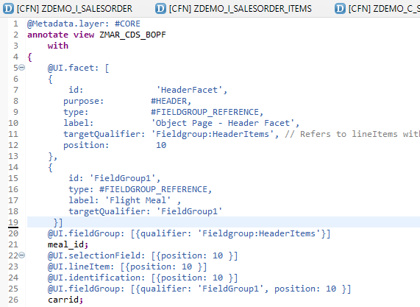
Meta Data Extension
A CDS metadata extension (MDE) extends a CDS entity with CDS annotations that are not defined in the CDS source code of the data definition. CDS metadata extensions can currently only be created for CDS views.
@Metadata.allowExtension: true
There can be several metadata extensions for one CDS entity. The following rules determine which metadata extension to use to evaluate the annotations:
Each metadata extension is assigned to a layer, such as branch, partner, or customer. The layer determines the priority of the evaluation.
A metadata extension can be joined to a CDS variant. The CDS variant can be specified during the evaluation of the annotations of a CDS entity to select the metadata extension.

Slide 13
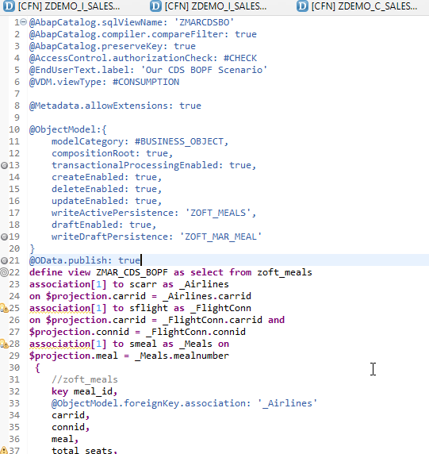
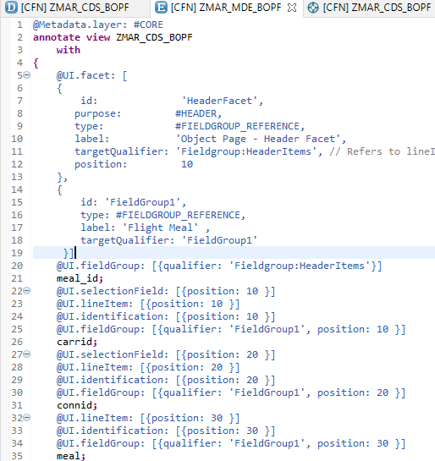
Transactional UX App with CDS & BOPF
Meta Data Annotation
Exercise
Meta Data CDS Code
Annotation for Filter
Line item Annotation

Slide 14
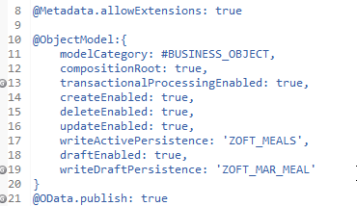
Draft Functionality
In SAP Fiori, drafts are used as follows: To keep unsaved changes if an editing activity is interrupted, allowing users to resume editing later. ... As a locking mechanism to prevent multiple users from editing the same object concurrently, and to make users aware when there are unsaved changes by another user.
Drafts are used as follows:
To keep unsaved changes if an editing activity is interrupted, allowing users to resume editing later.
To prevent data loss if an app terminates unexpectedly.
As a locking mechanism to prevent multiple users from editing the same object concurrently, and to make users aware when there are unsaved changes by another user.
Annotation for Draft Functionality

Slide 15

End of Day 16
Trainer: Anubhav Oberoy

Slide 16

Trainer: Anubhav Oberoy

Slide 17
THANK YOU
If you cannot do
great things, do small things in a great way.
Anubhav Oberoy
https://www.anubhavtrainings.com

Slide 18


We’re committed to empower you to be
Most Desirable Resource
through powerful training solutions.
We build the workforce of the future.
250+
Corporate Clients
30,000+
Learners Trained
25000+
Learners Placed
FREE WEBINARS
Sign up for free webinars with industry experts every fortnight!
Enroll Now!
Contact us today!
https://anubhavtrainings.com/

Slide 19




More from AnubhavTrainings.com

